Slide 1










ATAI
Advanced Techniqueof Artificial Intelligence
ATAI
ChongqingUniversity _{AdvancedTechniqueof}
of Technology Artificial Intelligence
Chongqing University of
Technology
Chongqing University ^{ATAI}
_{of Technology} Advanced Techniqueof
Artificial Intelligence
Chongqing University of Technology
Chongqing University of Technology
GLoMo: Global-Local Modal Fusion for Multimodal Sentiment
Analysis
Code:none
2024.9.26 •ChongQing
—— MM 2024
Reported by YaoChen Li
1

Slide 2

ATAI
AdvancedTechniqueof
Artificial Intelligence
ATAI
ChongqingUniversity _{AdvancedTechniqueof}
of Technology Artificial Intelligence
ChongqingUniversity of Technology
Motivation
1.Current MSA methodologies primarily rely on global representation extracted from different modalities to construct fusion networks.
2.How to integrate multiple local representations and how to better fuse local representations with global information remains an open question.

Slide 3

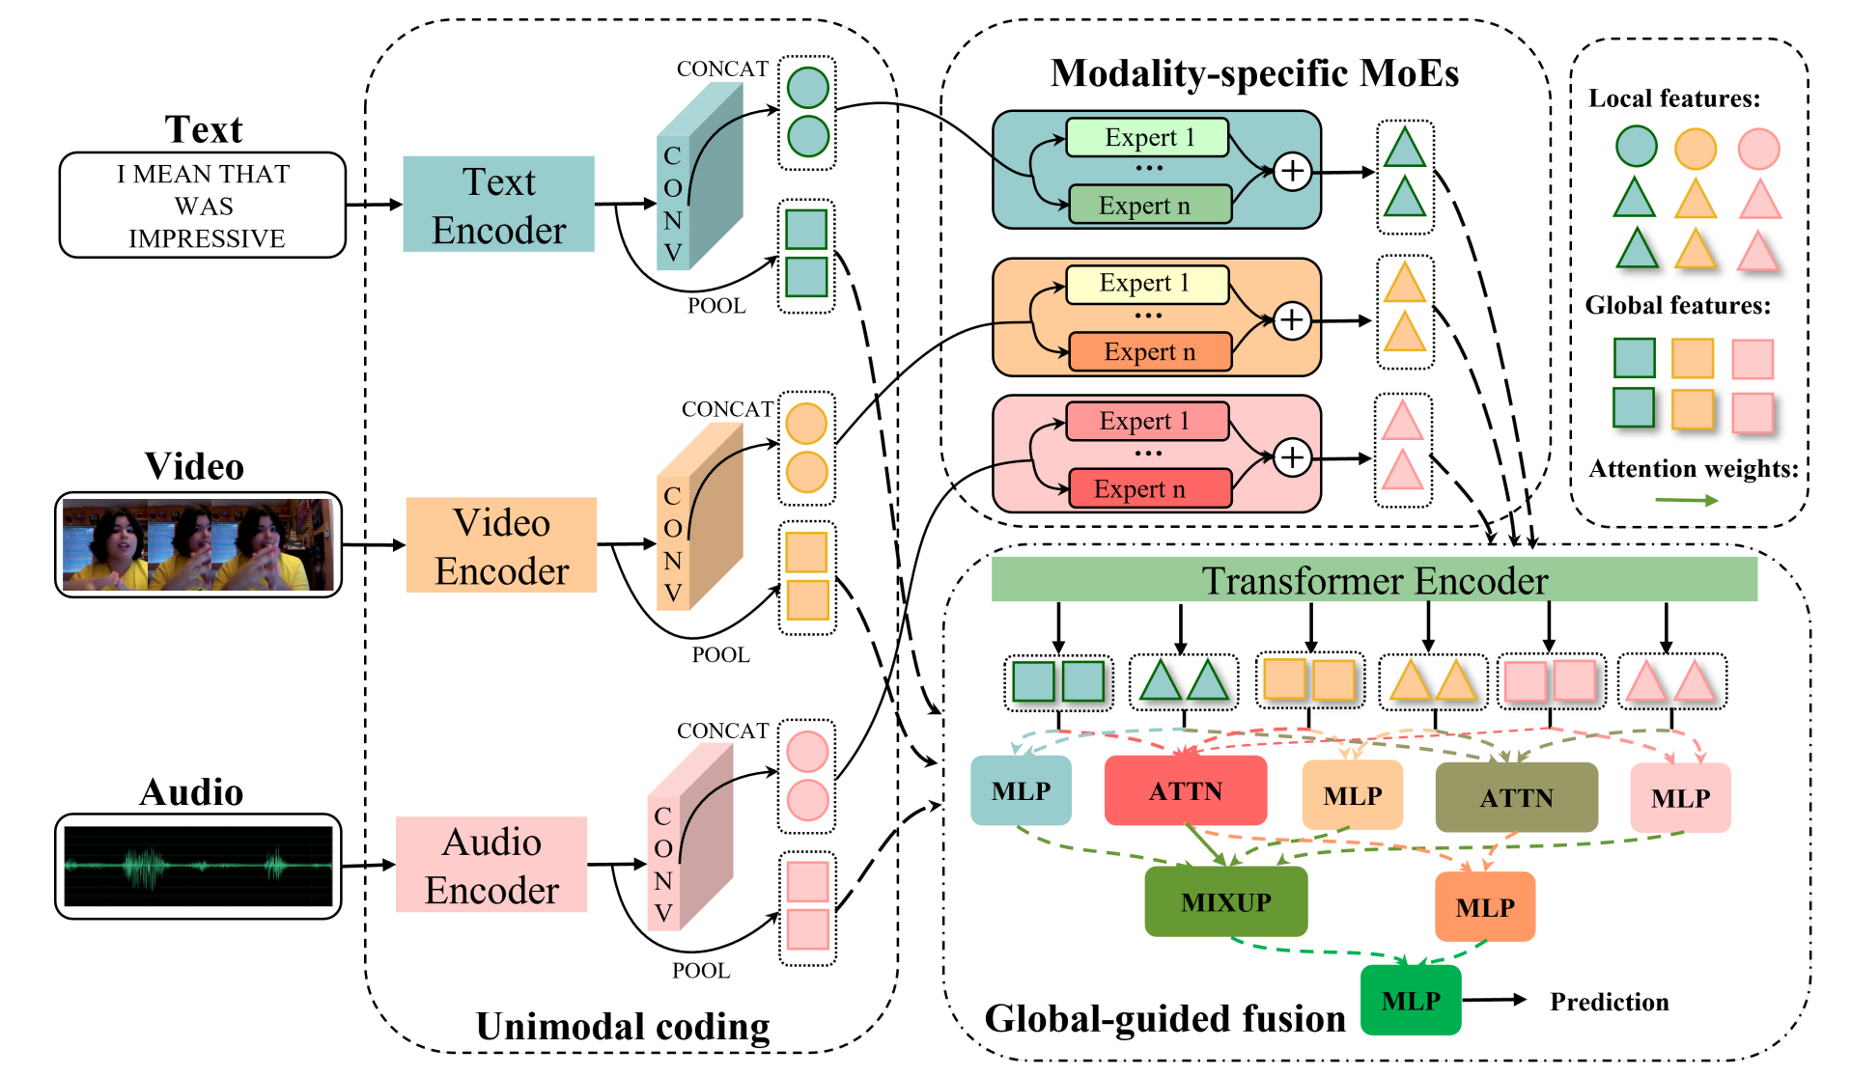
ChongqingUniversity of Technology
ATAI
AdvancedTechniqueof
Artificial Intelligence
ATAI
ChongqingUniversity _{AdvancedTechniqueof}
of Technology Artificial Intelligence
Overview

Slide 4

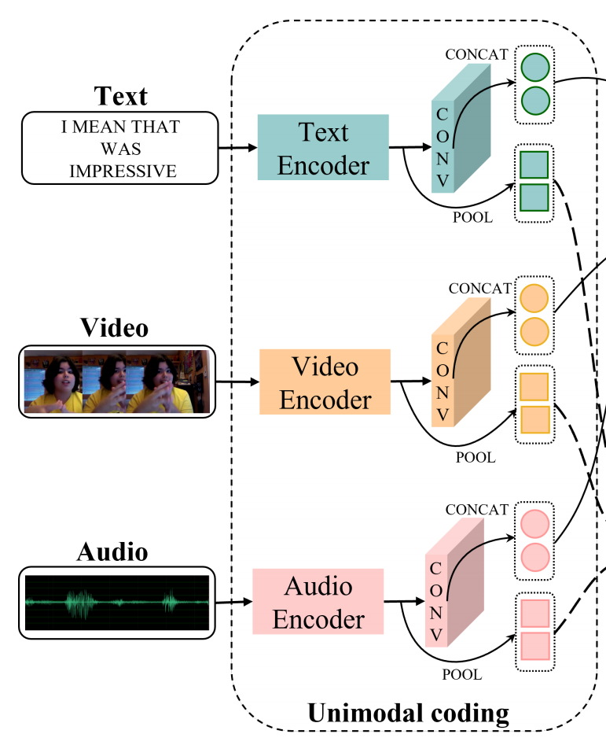
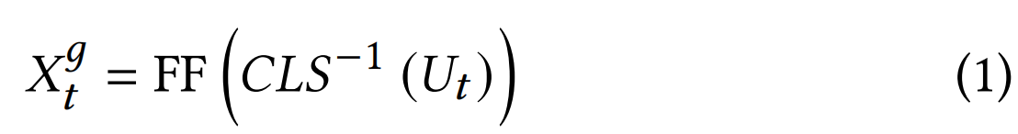
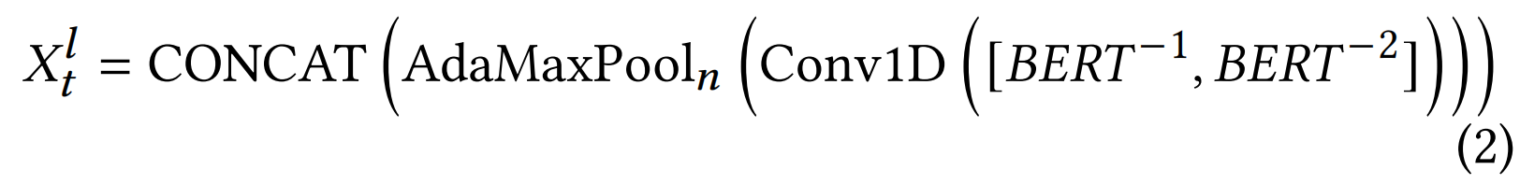
ChongqingUniversity of Technology
ATAI
AdvancedTechniqueof
Artificial Intelligence
ATAI
ChongqingUniversity _{AdvancedTechniqueof}
of Technology Artificial Intelligence
Method

Slide 5
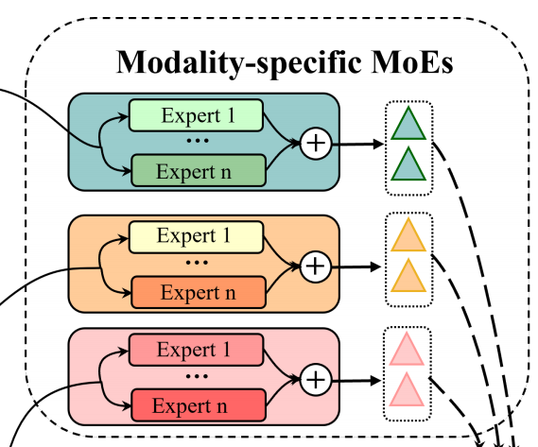

ChongqingUniversity of Technology
ATAI
AdvancedTechniqueof
Artificial Intelligence
ATAI
ChongqingUniversity _{AdvancedTechniqueof}
of Technology Artificial Intelligence
Method

Slide 6
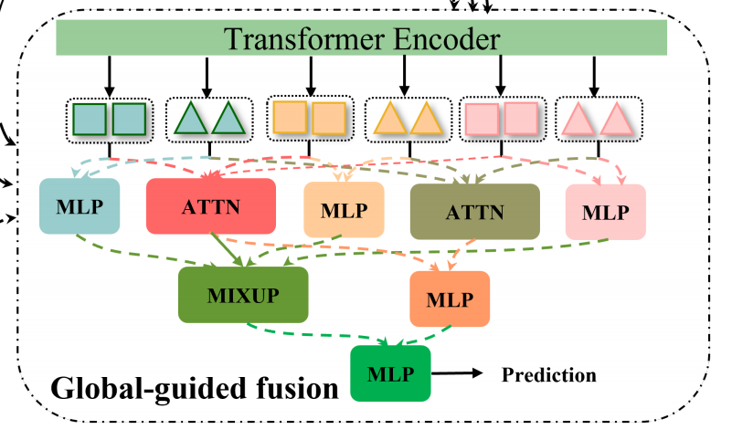

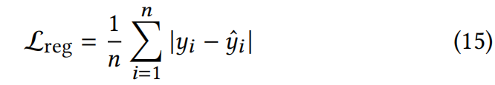
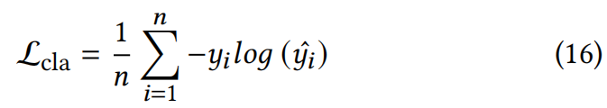
ChongqingUniversity of Technology
ATAI
AdvancedTechniqueof
Artificial Intelligence
ATAI
ChongqingUniversity _{AdvancedTechniqueof}
of Technology Artificial Intelligence
Method

Slide 7

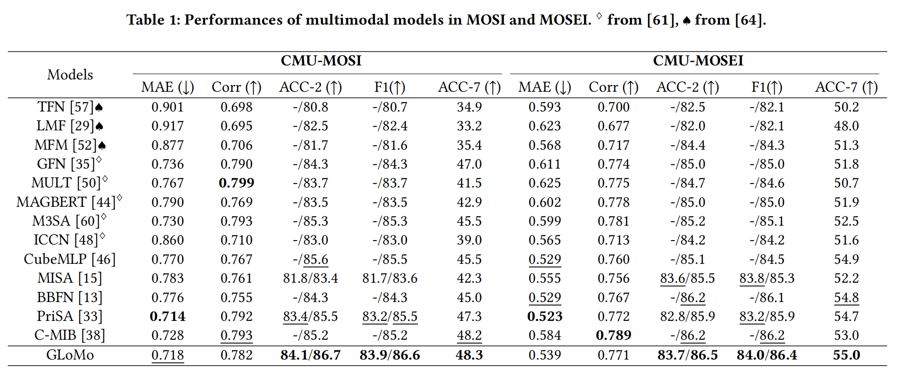
ATAI
AdvancedTechniqueof
Artificial Intelligence
ATAI
ChongqingUniversity _{AdvancedTechniqueof}
of Technology Artificial Intelligence
ChongqingUniversity of Technology
Experiments

Slide 8
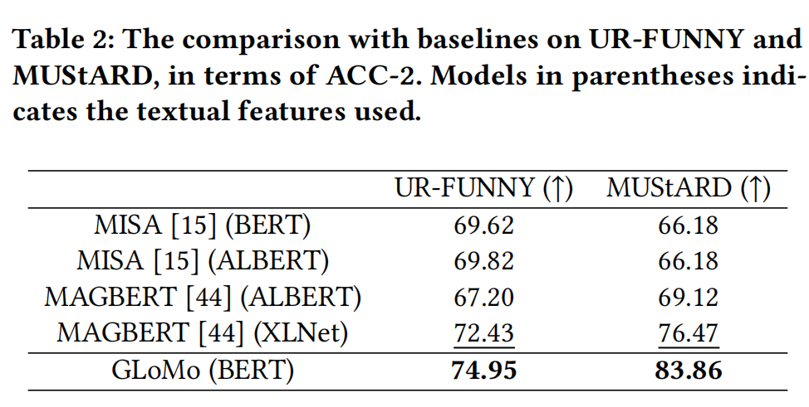
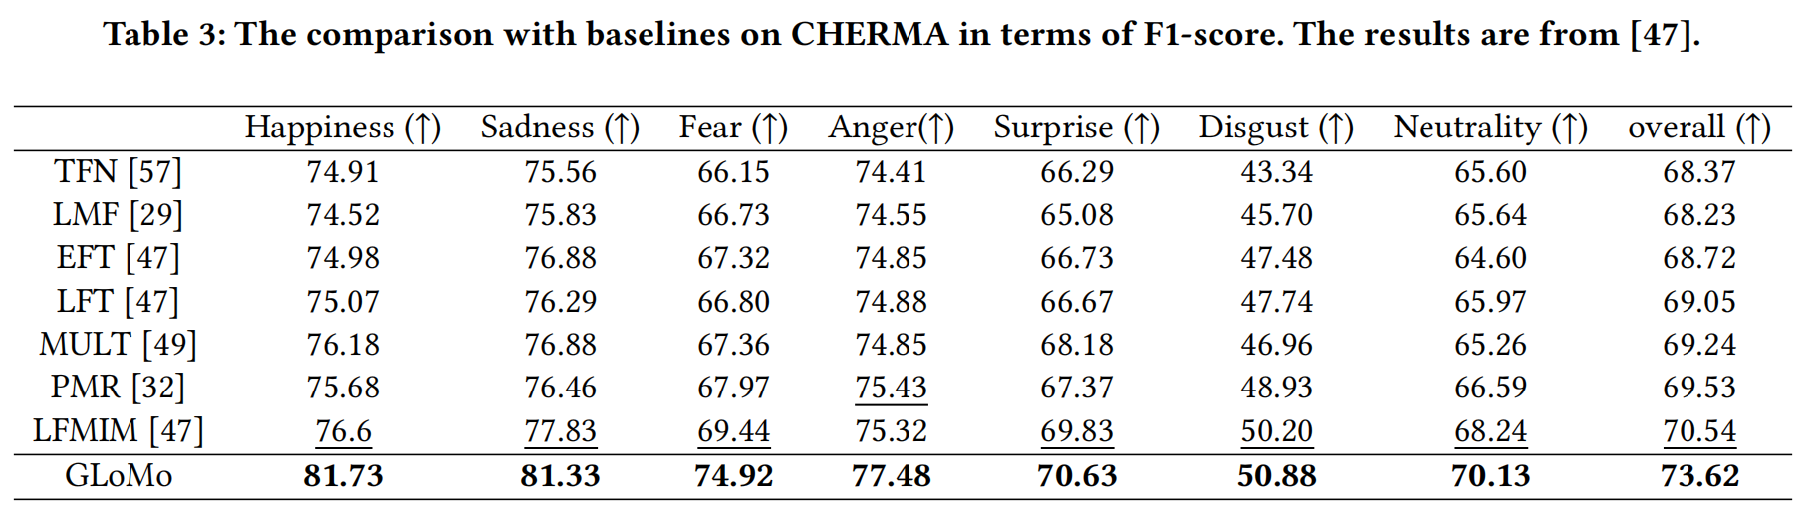
ATAI
AdvancedTechniqueof
Artificial Intelligence
ATAI
ChongqingUniversity _{AdvancedTechniqueof}
of Technology Artificial Intelligence
ChongqingUniversity of Technology
Experiments

Slide 9
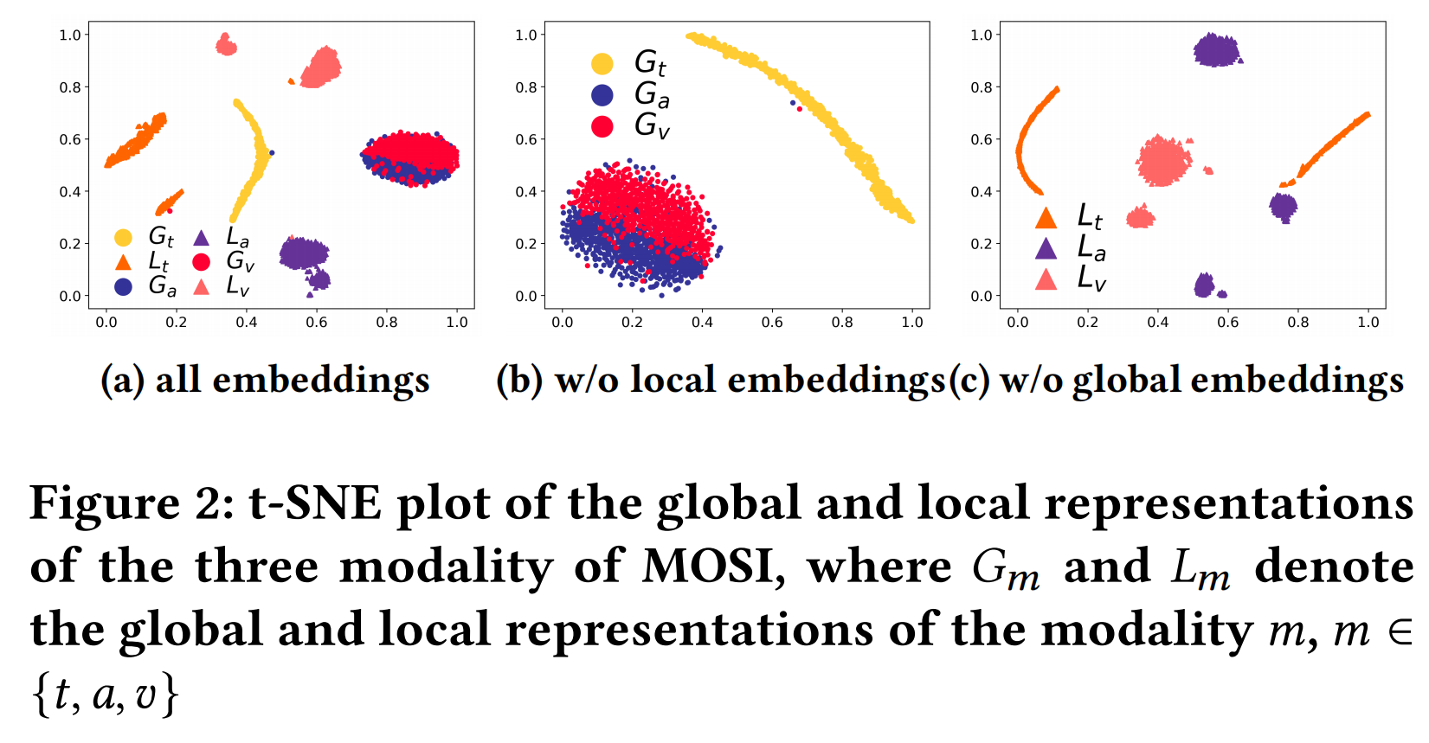
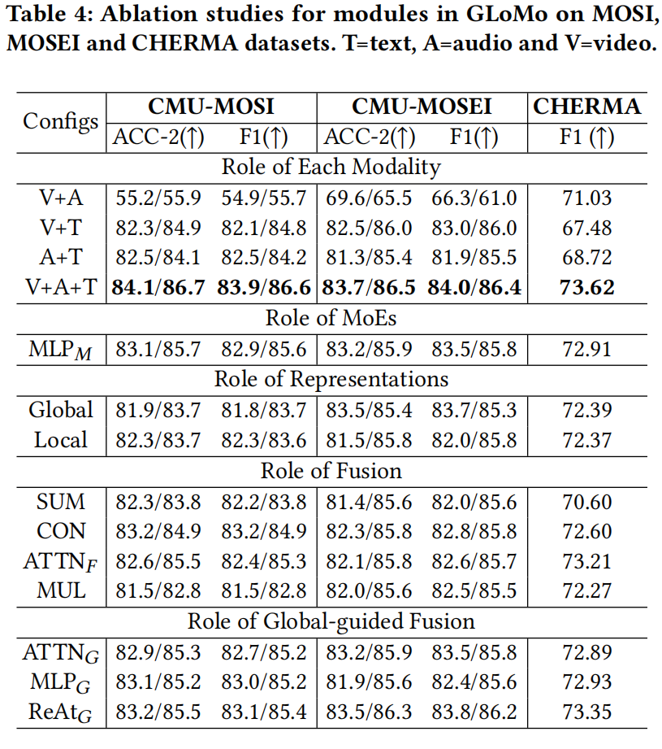
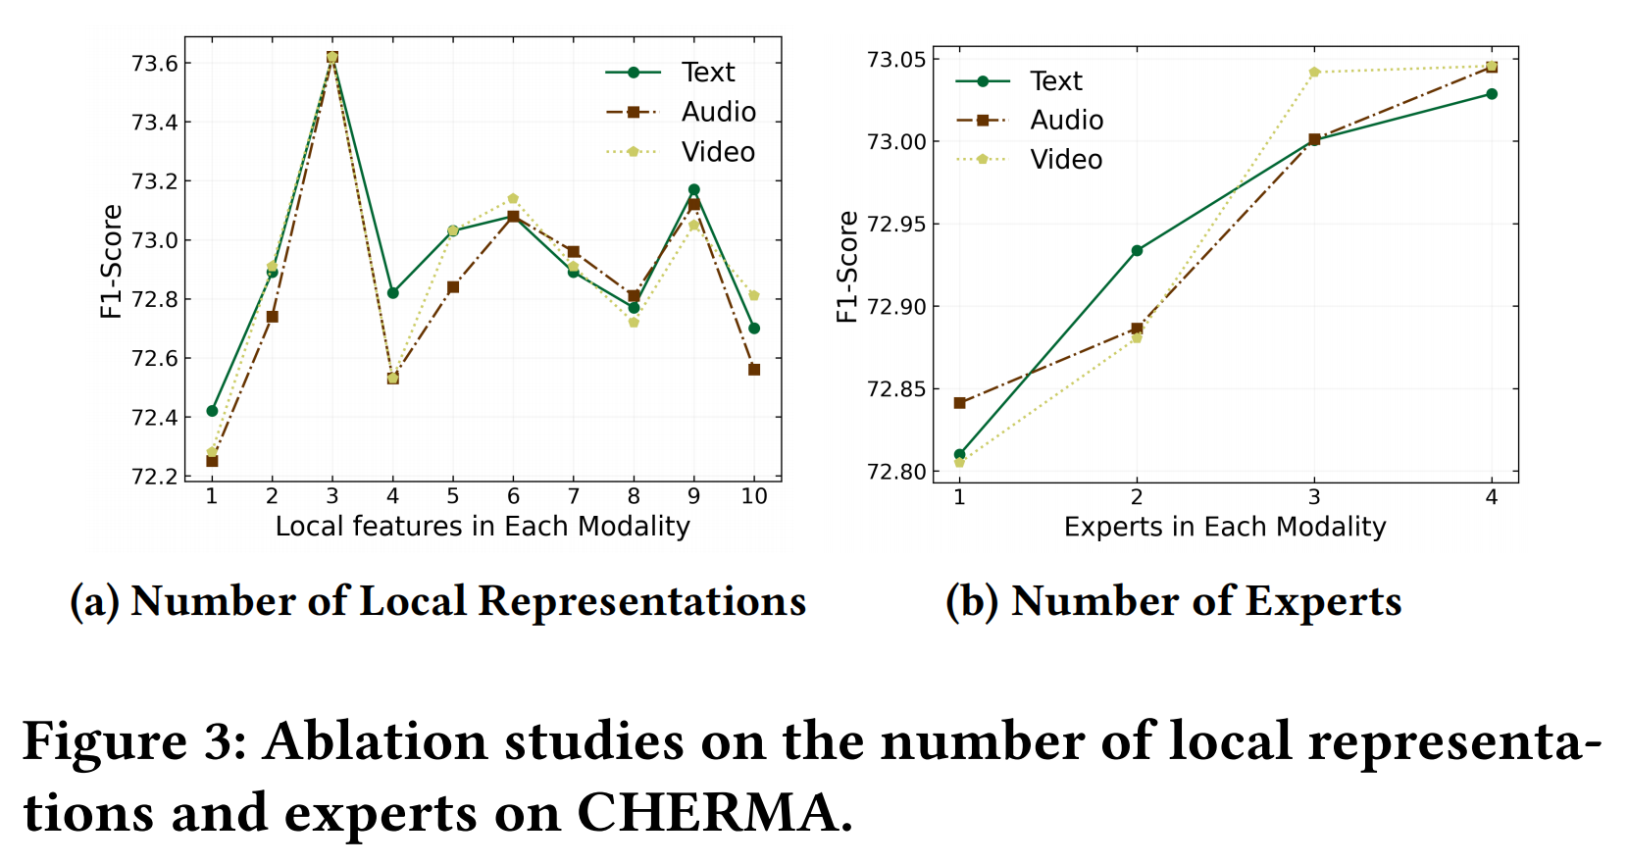
ChongqingUniversity of Technology
ATAI
AdvancedTechniqueof
Artificial Intelligence
ATAI
ChongqingUniversity _{AdvancedTechniqueof}
of Technology Artificial Intelligence
Experiments

Slide 10
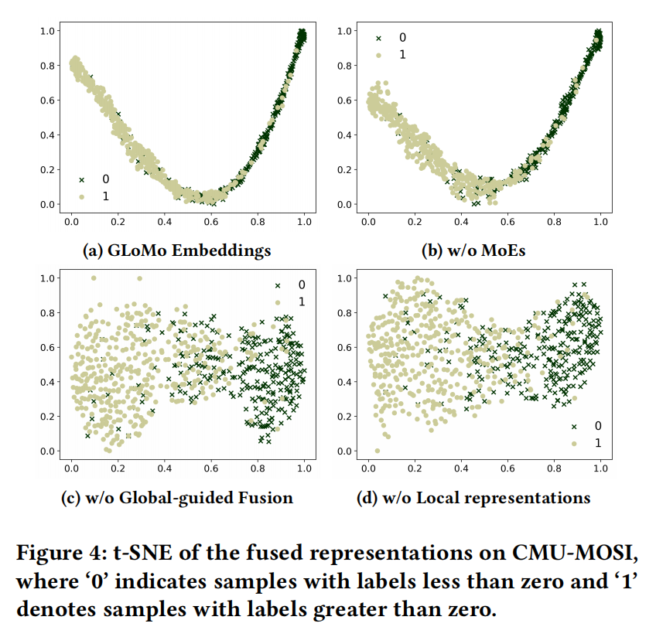
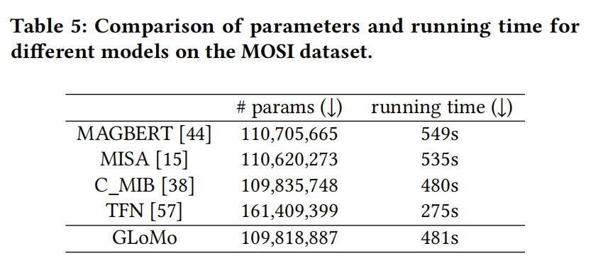
ChongqingUniversity of Technology
ATAI
AdvancedTechniqueof
Artificial Intelligence
ATAI
ChongqingUniversity _{AdvancedTechniqueof}
of Technology Artificial Intelligence
Experiments

Slide 11


ChongqingUniversity of Technology
ATAI
AdvancedTechniqueof
Artificial Intelligence
ATAI
ChongqingUniversity _{AdvancedTechniqueof}
of Technology Artificial Intelligence
Thanks!

